Slide 1
Target Detection of Military Vehicles Using SAR Images
Sunder R – HP22CSCI0200076
Vivek Molleti – HP22CSCI0200025
05/04/2024

Slide 2
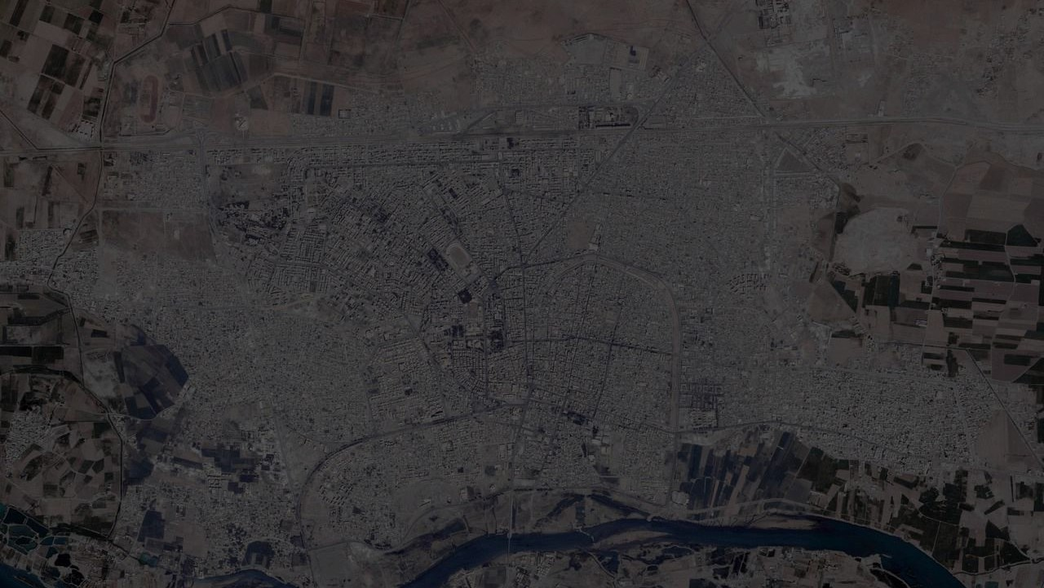
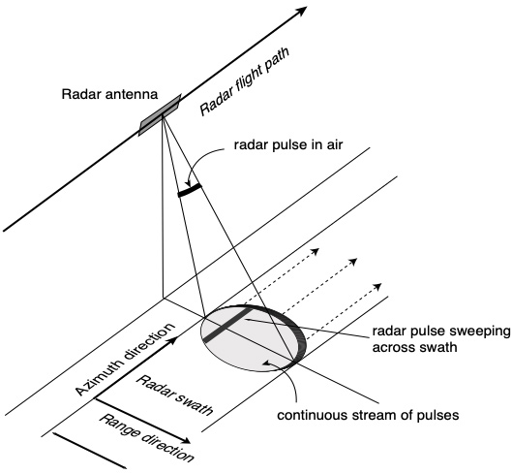
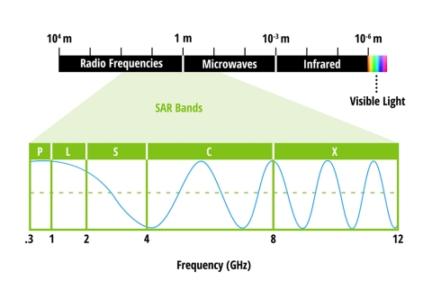
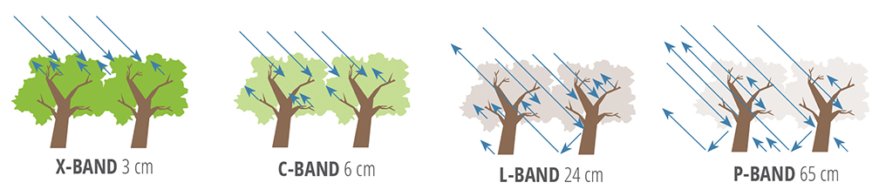
Introduction : Synthetic Aperture Radar (SAR)

Slide 3
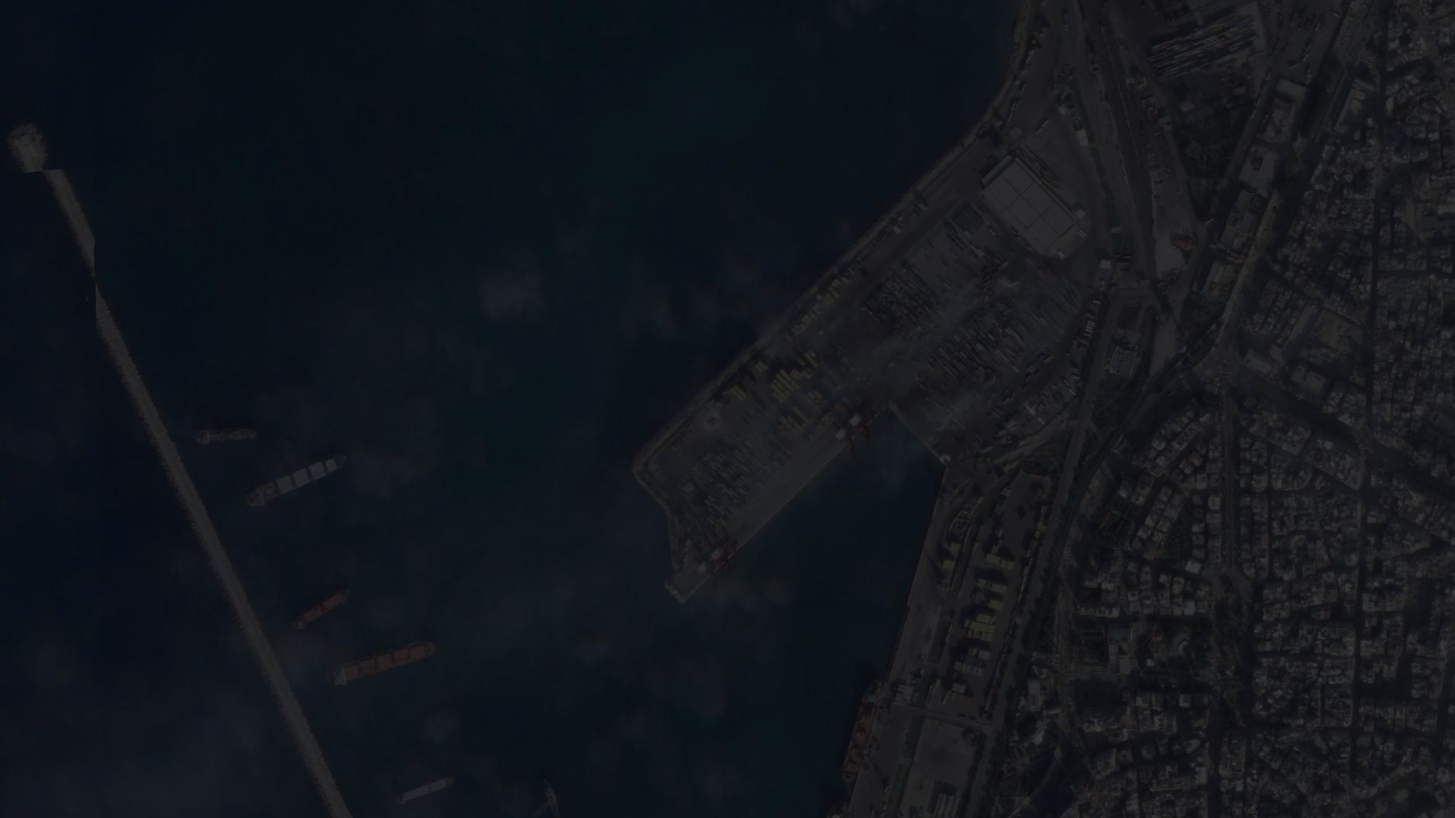
Problem Statement : Target detection in SAR images is crucial for military surveillance, requiring robust performance across varying depression angles. Traditional methods struggle with accuracy due to SAR imagery complexity and the need for adaptability to different observation angles. Existing research often overlooks real-world variability, focusing on specific angles.
Objective : Develop and optimize Convolutional Neural Network (CNN) models to achieve accurate target detection in Synthetic Aperture Radar (SAR) images. Specifically, the project aims to enhance accuracy under varying angles of depression(15,17,30 and 45) using the MSTAR dataset featuring 10 military vehicle classes with subset of 3 classes.

Slide 4
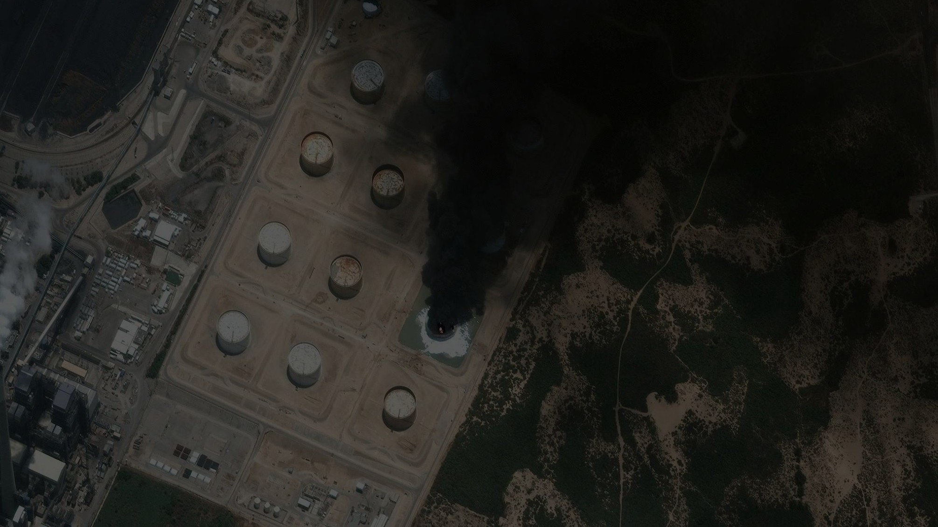
Literature review
Previous Research:
Worked mostly on 5 and 8 classes
Limited work on 30° and 45° angle of depression
Confined data preprocessing methods

Slide 5
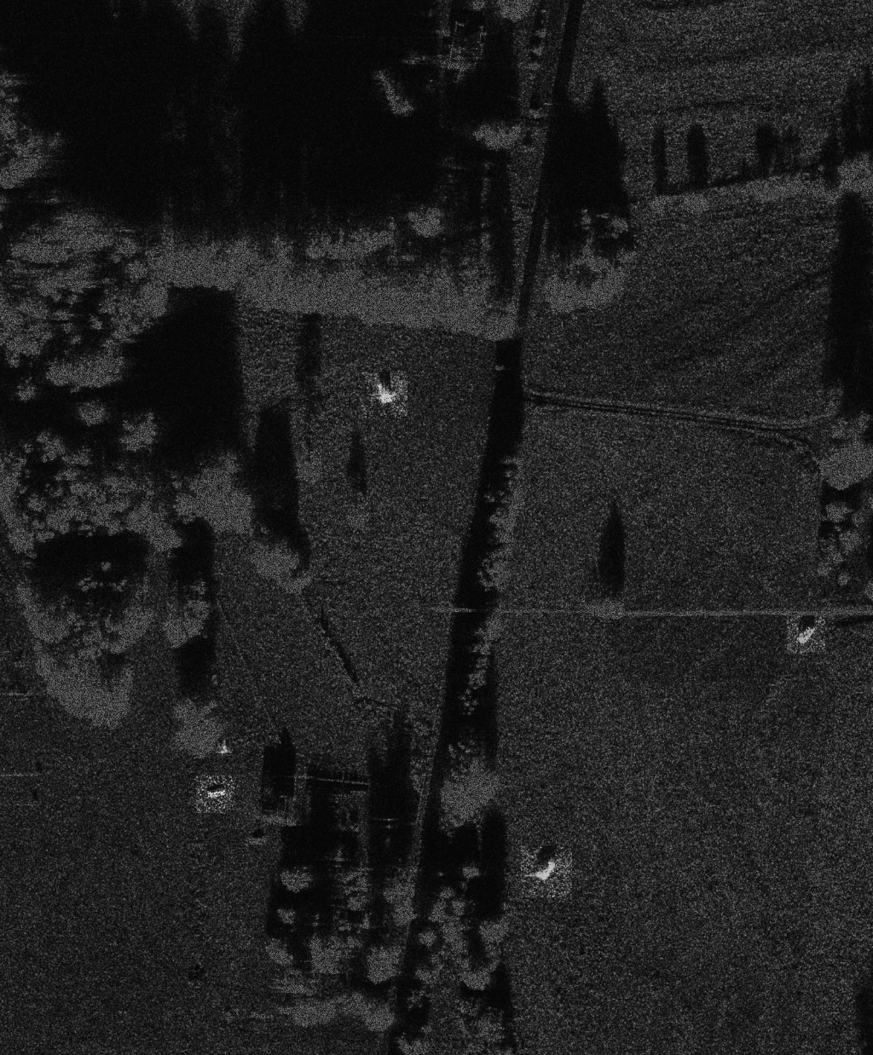
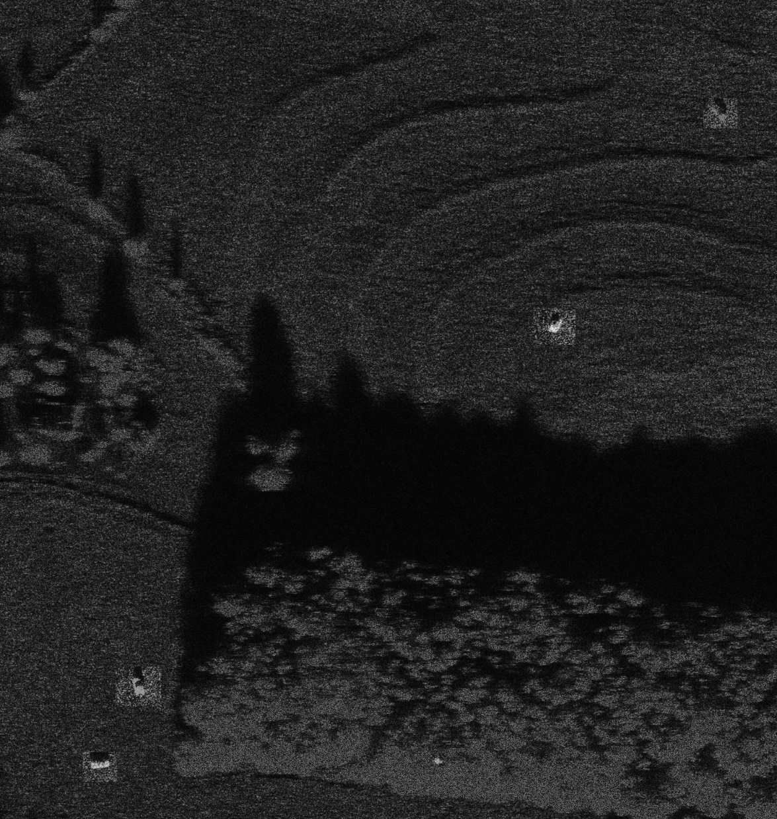
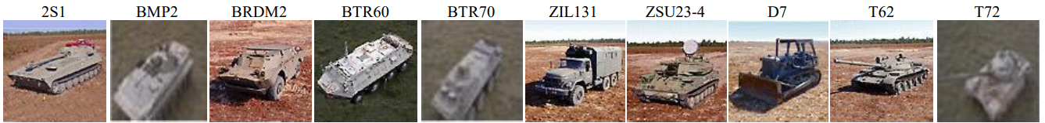
Data Description:
Data Description : Moving and Stationary Target Acquisition and Recognition (MSTAR) provided by The Sensor Data Management System (SDMS)
This dataset is collected by Defense Advanced Research Projects Agency (DARPA) and the Air Force Research Laboratory (AFRL) by using aerial X-band radar
Image size -158 x 158
No of classes – 10 for 15 and 17 degree angle of depression
3 for 30 and 45 degree angles of depression

Slide 6
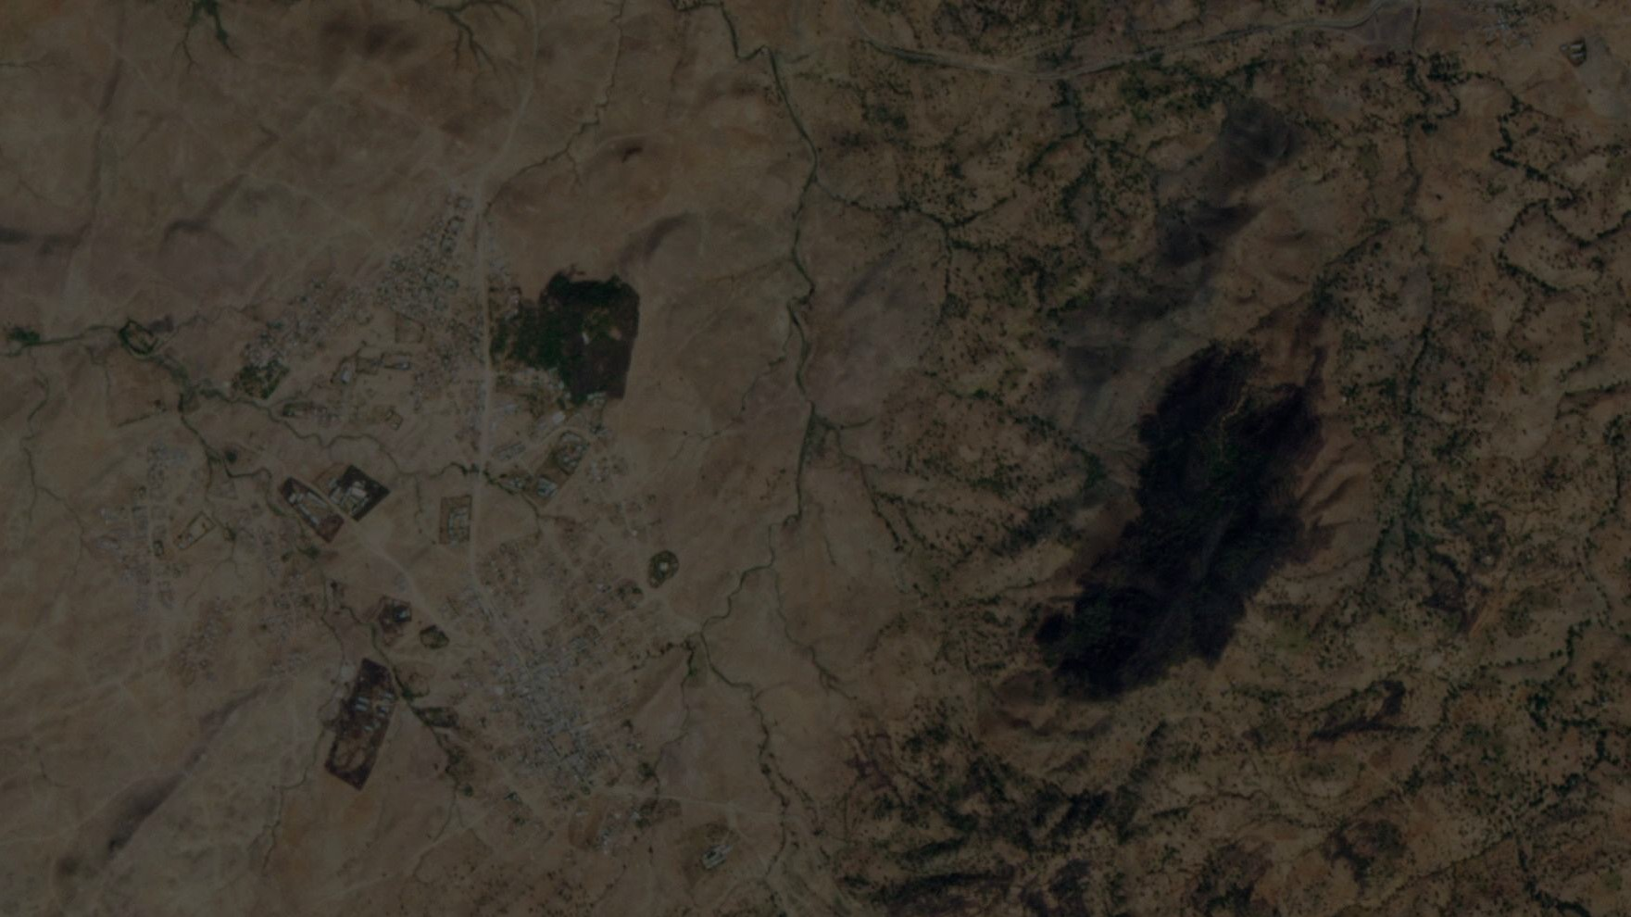
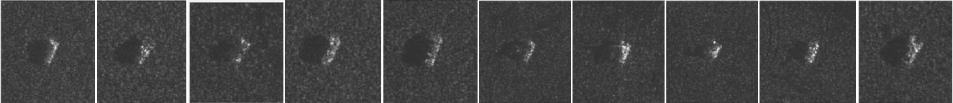
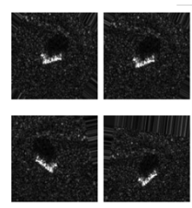
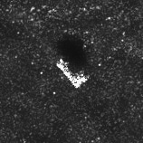
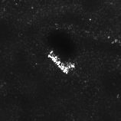
Data Preprocessing
Original 10 classes image data
2S1 BMP2 BRDM2 BTR60 BTR70 ZIL131 ZSU234 D7 T62 T72
Raw image without filter Image using Bilateral filter
Augmented Images

Slide 7
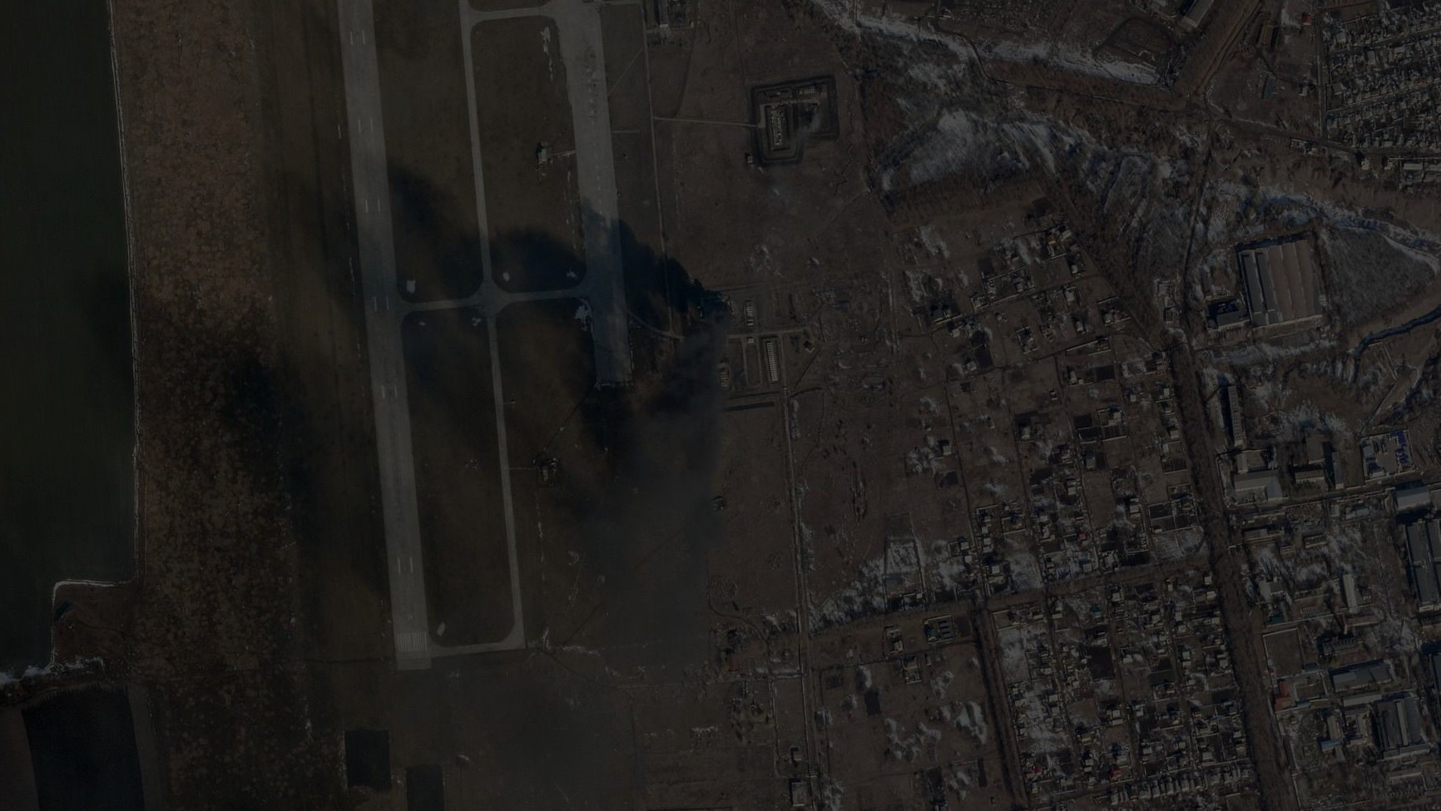
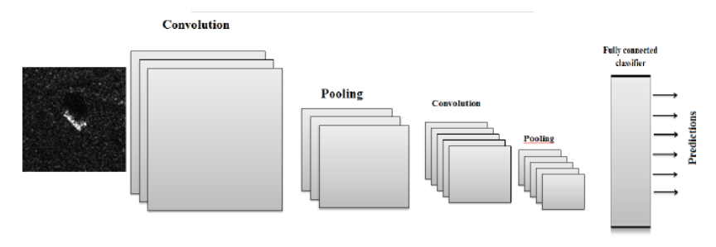
Methodology: Convolutional Neural Network (CNN)

Slide 8
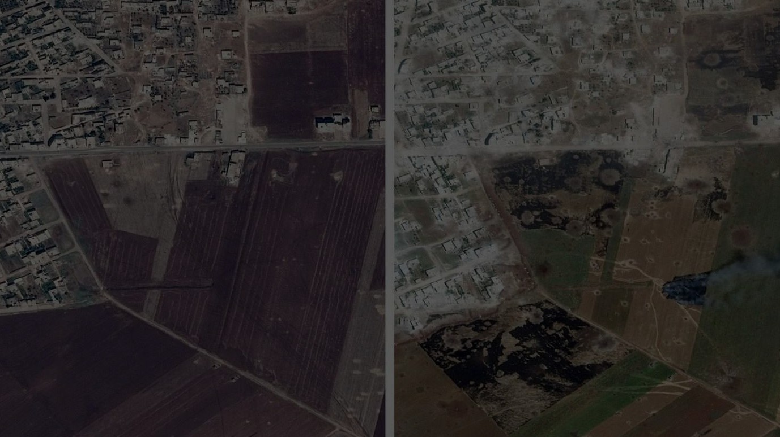
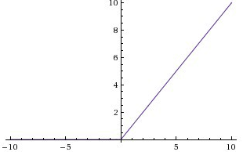
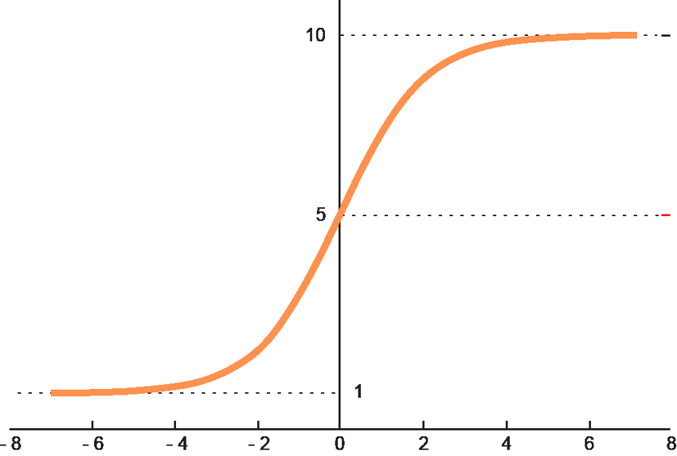
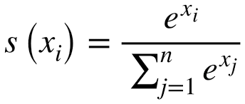
Activation Function
Relu
Softmax
A(x) = max(0,x)
Optimizers :
Adam
Adagrad
SGD
Loss Function:
Categorical Cross entropy

Slide 9
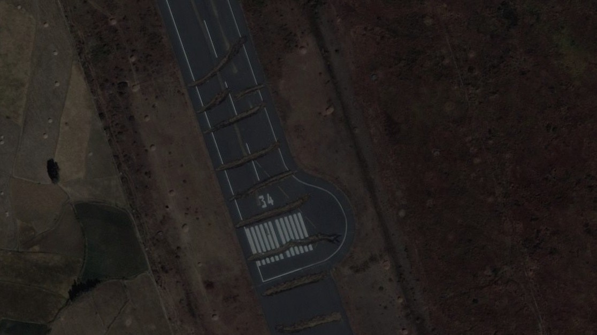
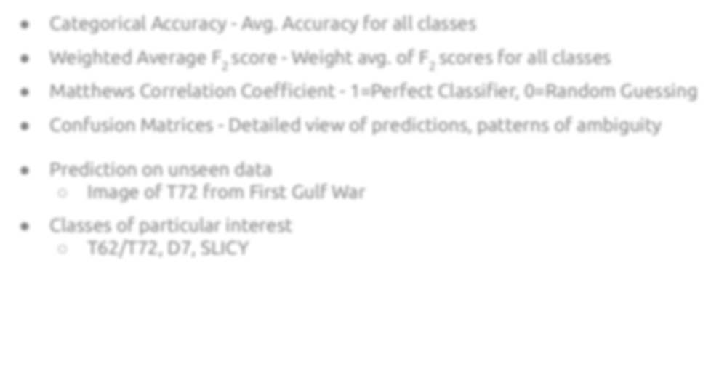
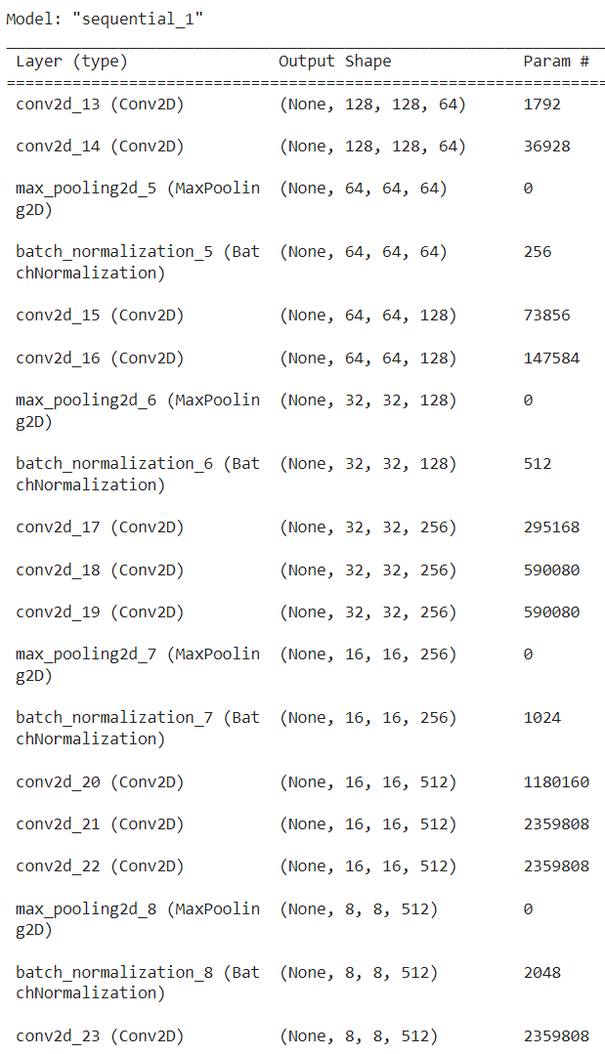
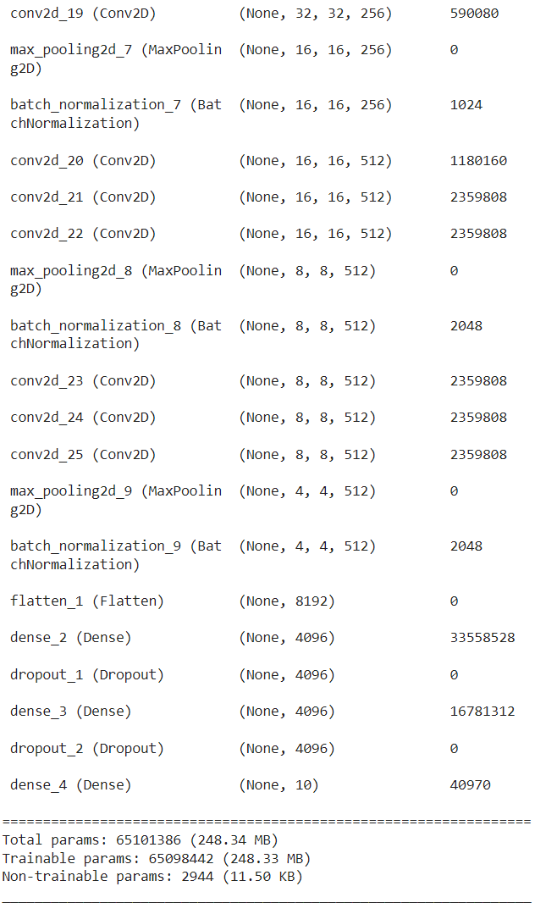
Custom Model
Batch Normalization
Regularization

Slide 10
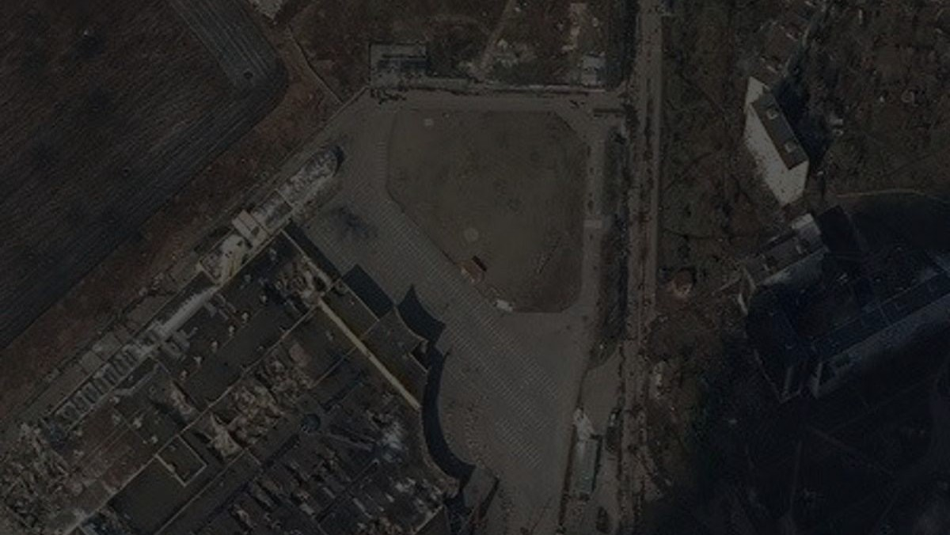
Results:
Model Evaluation Results for 10 Classes
Model Name | Input Size | Batch Size | Epoch | Optimizer | Accuracy(%)
ResNet | 128,128 | 64 | 20 | Adam | 48
Alexnet | 128,128 | 64 | 50 | Adam | 52
leNet | 128,128 | 64 | 100 | SGD | 90
Vgg16 | 128,128 | 64 | 50 | Adagrad | 60
Custom Model | 128,128 | 64 | 50 | Adagrad | 92
Model Evaluation Results for 3 Classes
Model Name | Input Size | Batch Size | Epoch | Optimizer | Accuracy(%)
leNet | 128,128 | 64 | 100 | Adam | 78
Vgg16 | 128,128 | 64 | 50 | Adagrad | 50
ResNet | 128,128 | 64 | 50 | Adagrad | 70
Custom Model | 128,128 | 64 | 50 | Adagrad | 81

Slide 11
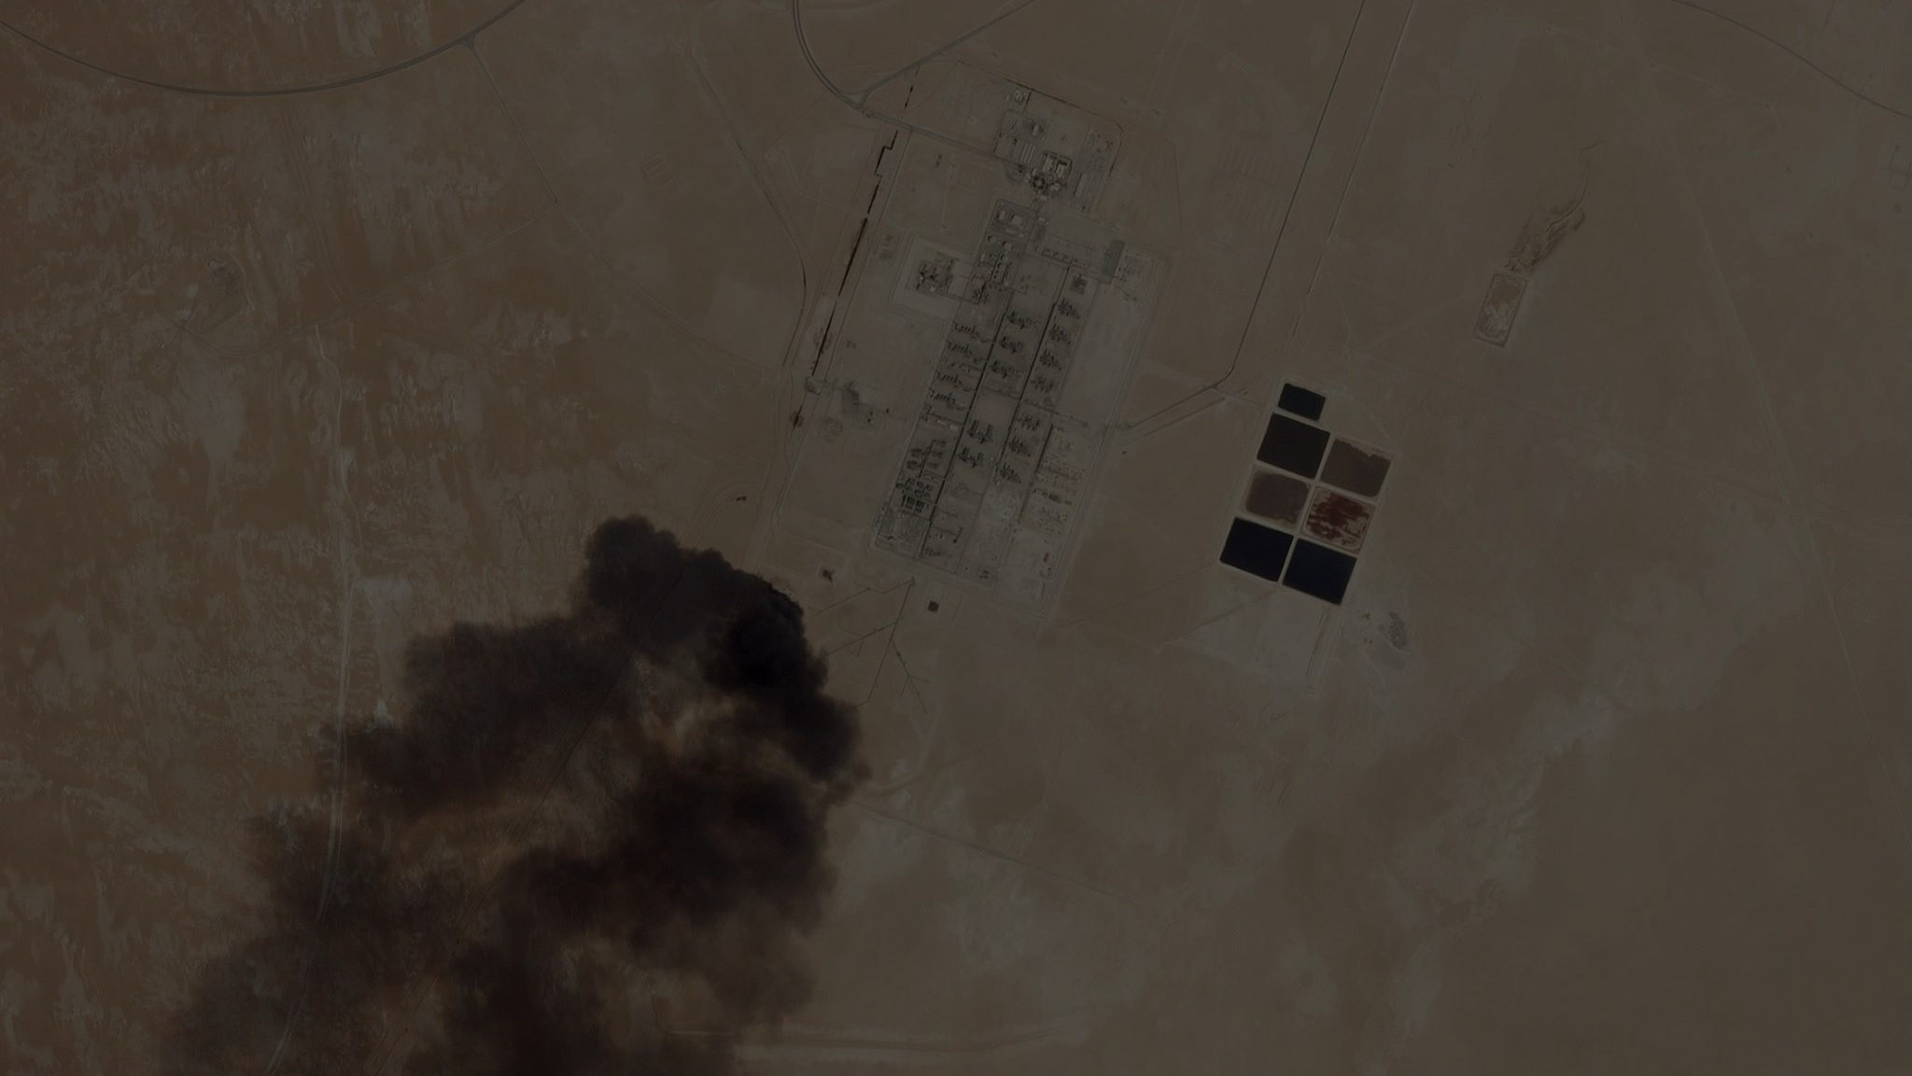
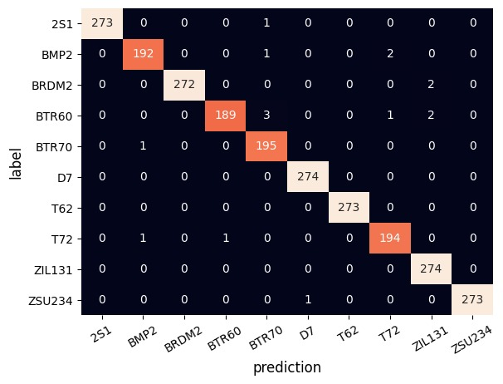
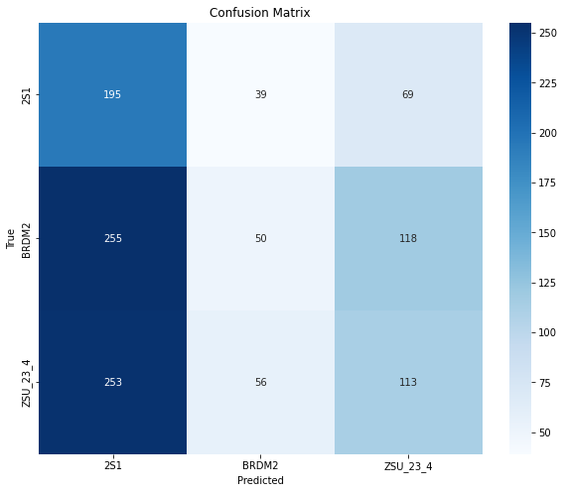
Confusion Matrix:
10 Classes 3 Classes

Slide 12
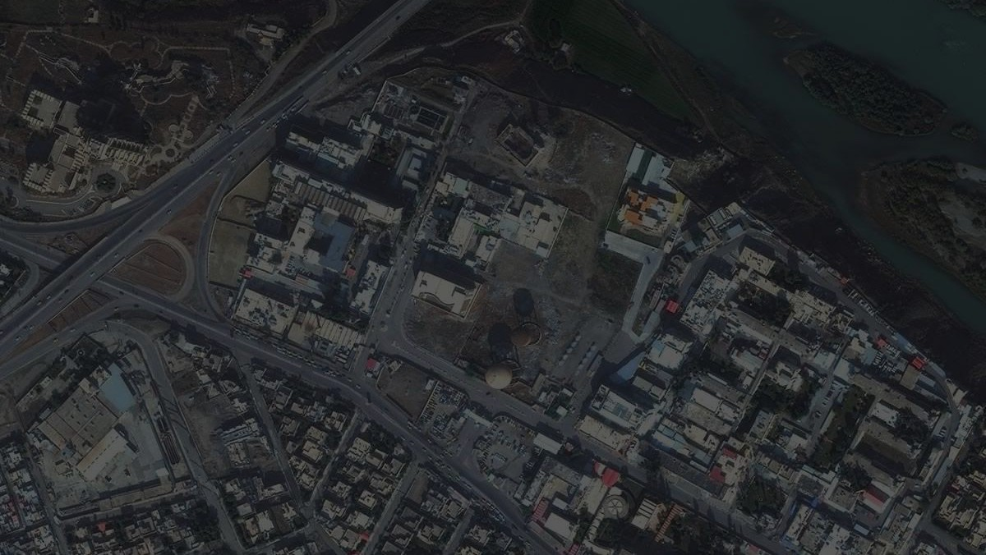
Limitations:
Data Limitations
Computational Complexities
Limited Clutter Information
Future Scope Of Work: 1. Implementation of SAR to Commercial vehicles
2. Developing for various Clutter Information
3. Anomaly Detection

Slide 13
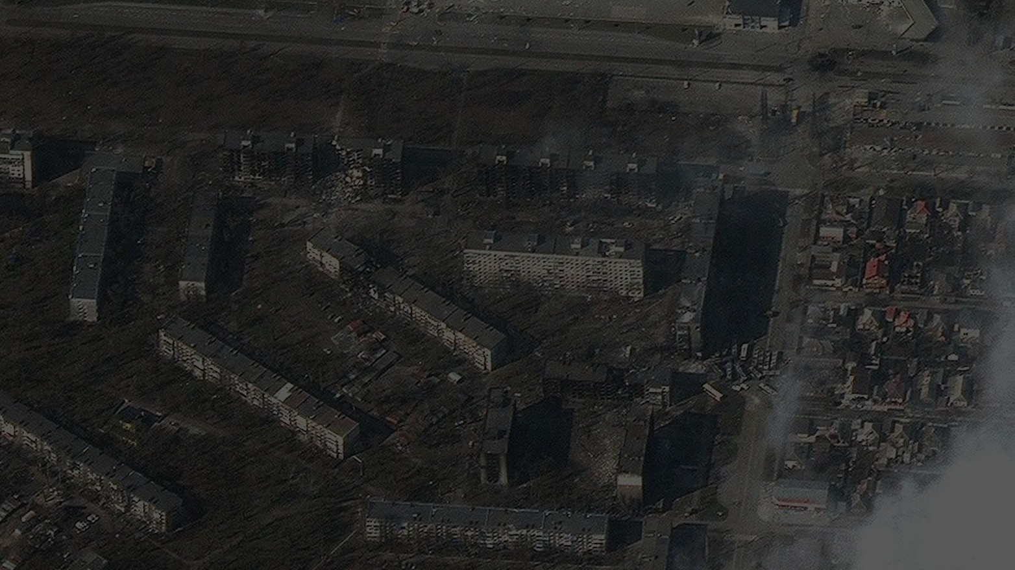
References:
[1] S. Liu, Z. Cao and H. Yang, "Information Theory-Based Target Detection for High-Resolution SAR Image," in IEEE Geoscience and Remote Sensing Letters, vol. 13, no. 3, pp. 404-408, March 2016
[2] Geng, Z.; Xu, Y.; Wang, B.-N.; Yu, X.; Zhu, D.-Y.; Zhang, G. Target Recognition in SAR Images by Deep Learning with Training Data Augmentation. Sensors 2023, 23, 941.
[3] R. Schumacher and J. Schiller, "Non-cooperative target identification of battlefield targets - classification results based on SAR images," IEEE International Radar Conference, 2005., Arlington, VA, USA, 2005, pp. 167-172,
[4] M. Afonso and J. M. Sanches, "Image reconstruction under multiplicative speckle noise using total variation", Neurocomputing, vol. 150, pp. 200-213, Feb. 2015.
[5] H. Kato and J. W. Goodman, "Nonlinear filtering in coherent optical systems through halftone screen processes", Appl. Opt., vol. 14, no. 8, pp. 1813-1824, Aug. 1975.

Slide 14
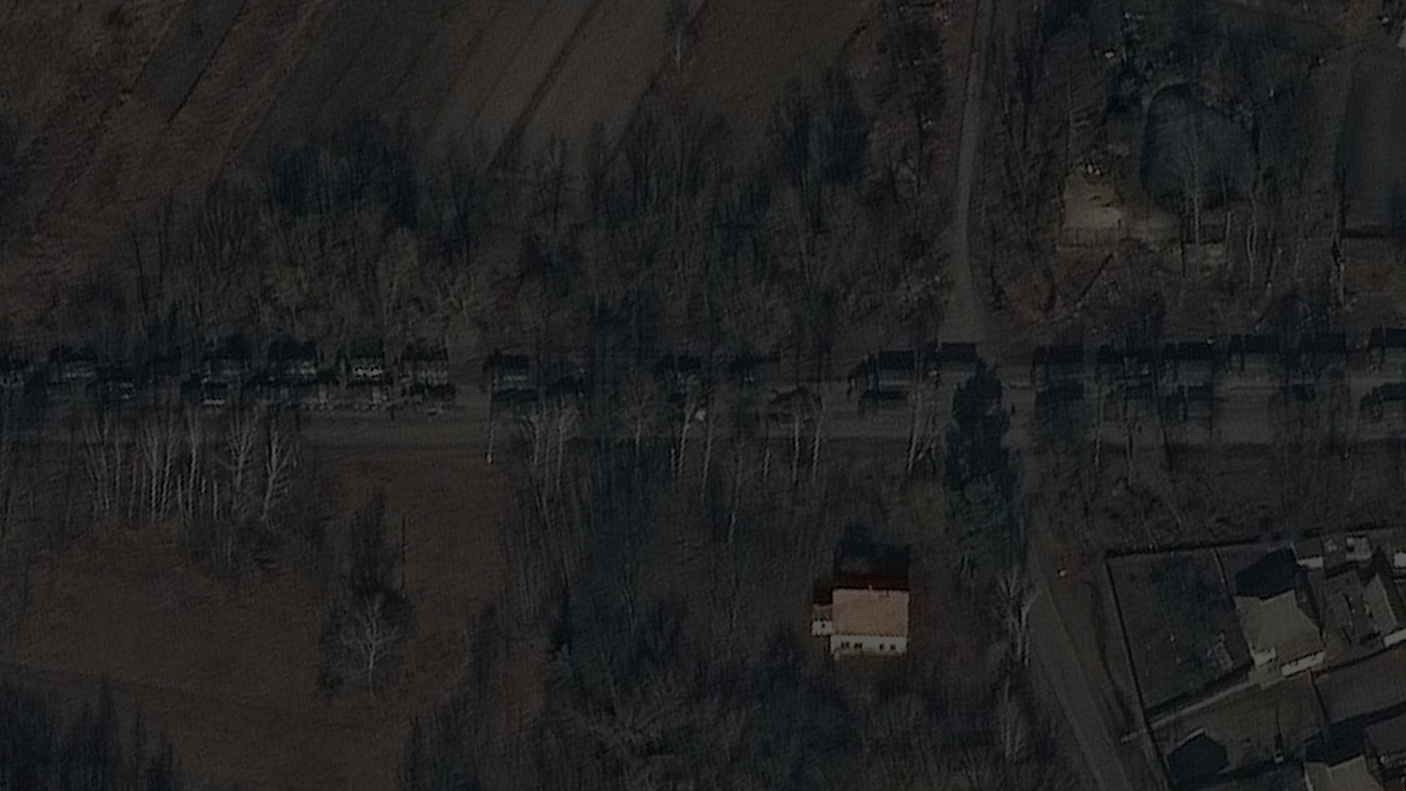
[15] K. El-Darymli, E. W. Gill, P. McGuire, D. Power, and C. Moloney, “Automatic Target Recognition in Synthetic Aperture Radar Imagery: A State-of-the-Art Review,” IEEE Access, vol. 4, pp. 6014–6058, 2016.
[16] Cheng J, Xiang D, Tang J, Zheng Y, Guan D, Du B. Inshore Ship Detection in Large-Scale SAR Images Based on Saliency Enhancement and Bhattacharyya-like Distance. Remote Sensing. 2022;14(12):N.PAG.
[17] Li, J.; Yu, Z.; Yu, L.; Cheng, P.; Chen, J.; Chi, C. A Comprehensive Survey on SAR ATR in Deep-Learning Era. Remote Sens. 2023, 15, 1454.
[18] Kechagias-Stamatis, Odysseas & Aouf, Nabil. (2020). Automatic Target Recognition on Synthetic Aperture Radar Imagery: A Survey. 10.13140/RG.2.2.16595.20008.
[19] Chen, Sizhe & Wang, Haipeng. (2015). SAR target recognition based on deep learning. DSAA 2014 - Proceedings of the 2014 IEEE International Conference on Data Science and Advanced Analytics. 541-547. 10.1109/DSAA.2014.7058124.
[20] Pei, Jifang & Huang, Yuhsuan & Huo, Weibo & Zhang, Yin & Yang, J.M. & Yeo, Tat-Soon. (2017). SAR Automatic Target Recognition Based on Multiview Deep Learning Framework. IEEE Transactions on Geoscience and Remote Sensing. PP. 1-15. 10.1109/TGRS.2017.2776357.

Slide 15
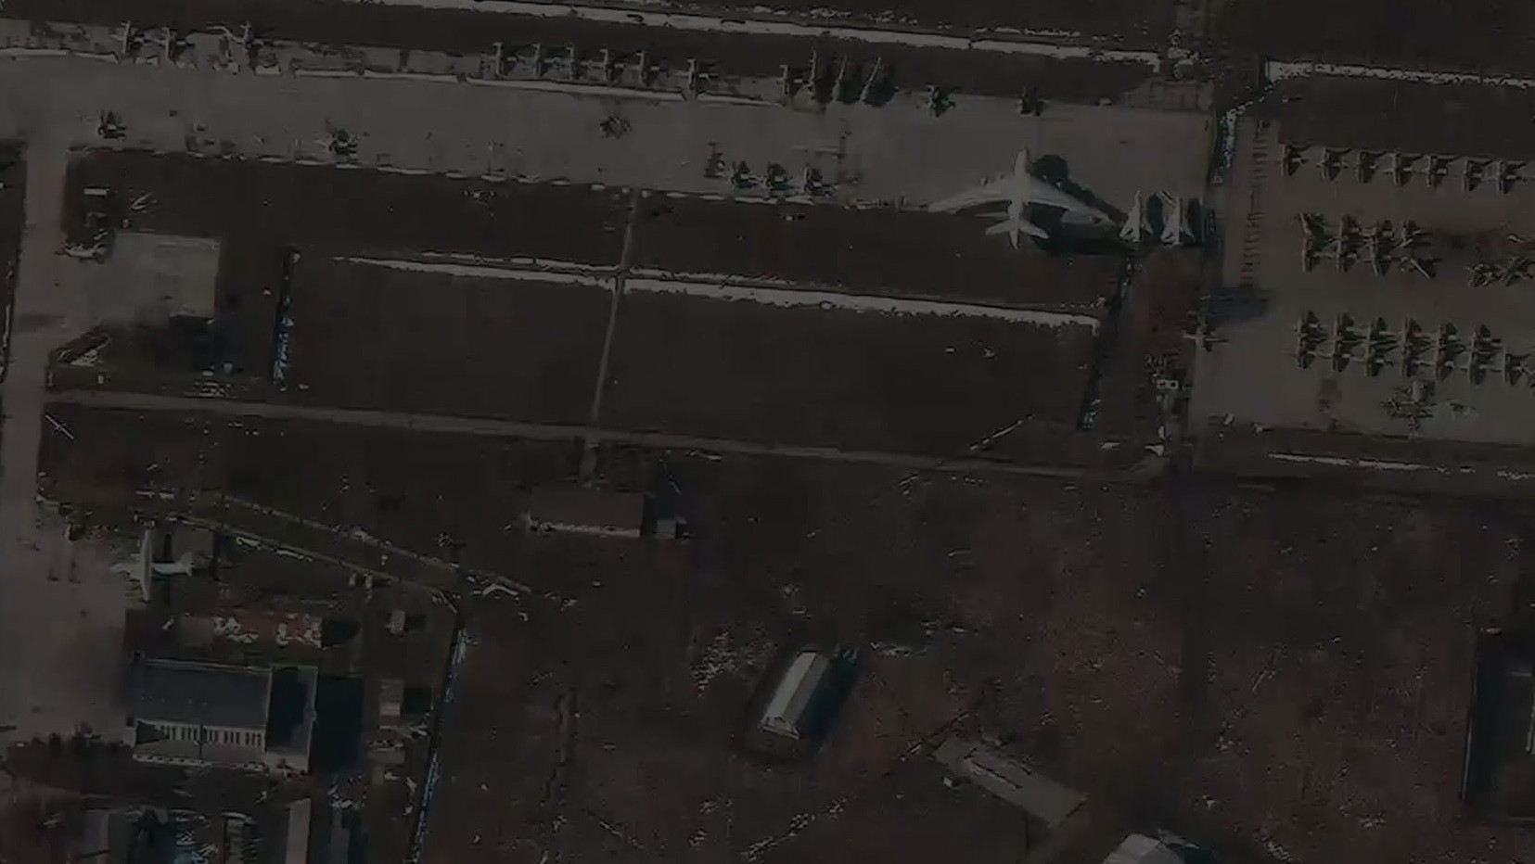
Thank you

